Slide 1
Javad Lavaei Department of Electrical Engineering Columbia University
An Efficient Computational Method for Large-Scale Operations Planning in Power Systems

Slide 2
Acknowledgements
Caltech: Steven Low, Somayeh Sojoudi
Columbia University: Ramtin Madani
UC Berkeley: David Tse, Baosen Zhang
Stanford University: Stephen Boyd, Eric Chu, Matt Kranning
J. Lavaei and S. Low, "Zero Duality Gap in Optimal Power Flow Problem," IEEE Transactions on Power Systems, 2012.
J. Lavaei, D. Tse and B. Zhang, "Geometry of Power Flows in Tree Networks,“ in IEEE Power & Energy Society General Meeting, 2012.
S. Sojoudi and J. Lavaei, "Physics of Power Networks Makes Hard Optimization Problems Easy To Solve,“ in IEEE Power & Energy Society General Meeting, 2012.
M. Kraning, E. Chu, J. Lavaei and S. Boyd, "Message Passing for Dynamic Network Energy Management," Submitted for publication, 2012.
S. Sojoudi and J. Lavaei, "Semidefinite Relaxation for Nonlinear Optimization over Graphs with Application to Optimal Power Flow Problem," Working draft, 2012.
S. Sojoudi and J. Lavaei, "Convexification of Generalized Network Flow Problem with Application to Optimal Power Flow," Working draft, 2012.

Slide 3
Power Networks (CDC 10, Allerton 10, ACC 11, TPS 11, ACC 12, PGM 12)
Optimizations:
Resource allocation
State estimation
Scheduling
Issue: Nonlinearities
(power quadratic in voltage)
Transition from traditional grid to smart grid:
More variables (10X)
Time constraints (100X)
Javad Lavaei, Columbia University
3

Slide 4
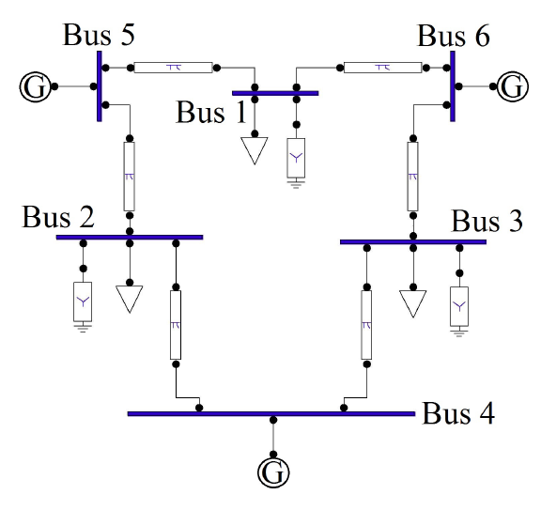
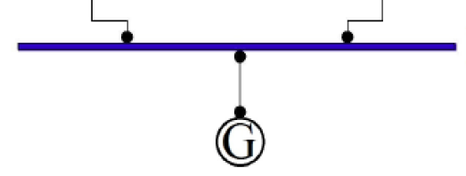
Resource Allocation: Optimal Power Flow (OPF)
Voltage V
Current I
Complex power = VI*=P + Q i
OPF: Given constant-power loads, find optimal P’s subject to:
Demand constraints
Constraints on V’s, P’s, and Q’s.
Javad Lavaei, Columbia University
4

Slide 5
Broad Interest in Optimal Power Flow
Interested companies: ISOs, TSOs, RTOs, Utilities, FERC
OPF solved on different time scales:
Electricity market
Real-time operation
Security assessment
Transmission planning
Existing methods based on linearization or local search
Can save $$$ if solved efficiently
Huge literature since 1962 by power, OR and Econ people
Recent conference by Federal Energy Regulatory Commission about OPF
Javad Lavaei, Columbia University
5

Slide 6
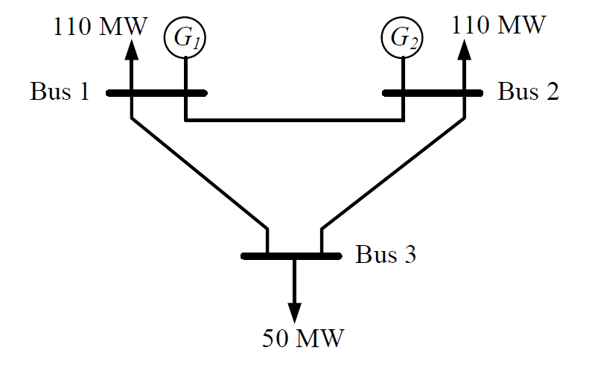
Local Solutions
P₁
P₂
OPF
Local solution: $1502 Global solution: $338
Javad Lavaei, Columbia University
6

Slide 7
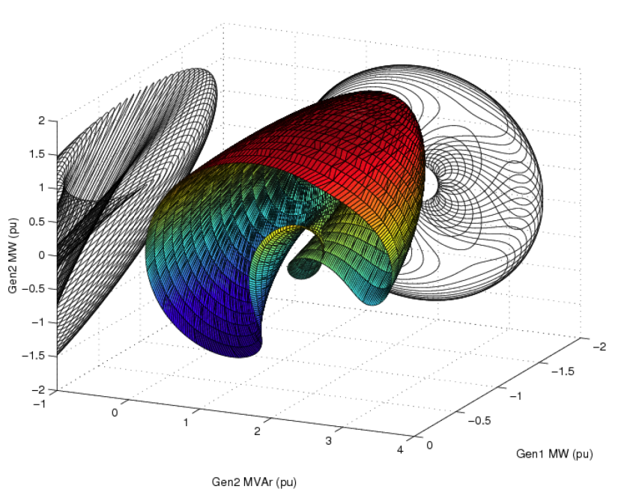
Local Solutions
Source of Difficulty: Power is quadratic in terms of complex voltages.
Anya Castillo et al.
Ian Hiskens from Umich:
Study of local solutions by Edinburgh’s group
Javad Lavaei, Columbia University
7

Slide 8
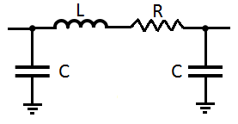
Summary of Results
Project 1: How to solve a given OPF in polynomial time? (joint work with Steven Low)
A sufficient condition to globally solve OPF:
Numerous randomly generated systems
IEEE systems with 14, 30, 57, 118, 300 buses
European grid
Various theories: It holds widely in practice
Project 2: Find network topologies over which optimization is easy? (joint work with Somayeh Sojoudi, David Tse and Baosen Zhang)
Distribution networks are fine.
Every transmission network can be turned into a good one.
Javad Lavaei, Columbia University
8

Slide 9
Summary of Results
Project 3: How to design a distributed algorithm for solving OPF? (joint work with Stephen Boyd, Eric Chu and Matt Kranning)
A practical (infinitely) parallelizable algorithm
It solves 10,000-bus OPF in 0.85 seconds on a single core machine.
Project 4: How to do optimization for mesh networks? (joint work with Ramtin Madani)
Project 5: How to relate the polynomial-time solvability of an optimization to its structural properties? (joint work with Somayeh Sojoudi)
Project 6: How to solve generalized network flow (CS problem)? (joint work with Somayeh Sojoudi)
Javad Lavaei, Columbia University
9

Slide 10
Geometric Intuition: Two-Generator Network
Javad Lavaei, Columbia University
10

Slide 11
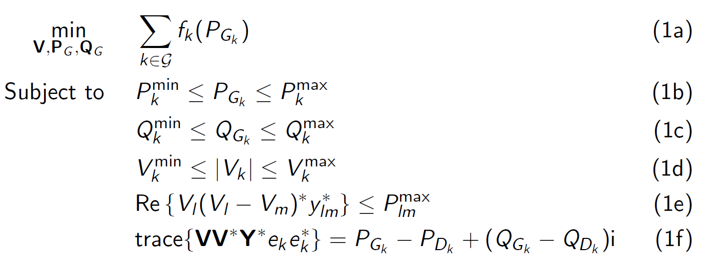
Optimal Power Flow
Cost
Operation
Flow
Balance
Extensions:
Other objective (voltage support, reactive power, deviation)
More variables, e.g. capacitor banks, transformers
Preventive or corrective contingency constraints
Multi-period OPF
Conventional OPF captures common sources of non-convexity.
Javad Lavaei, Columbia University
11

Slide 12
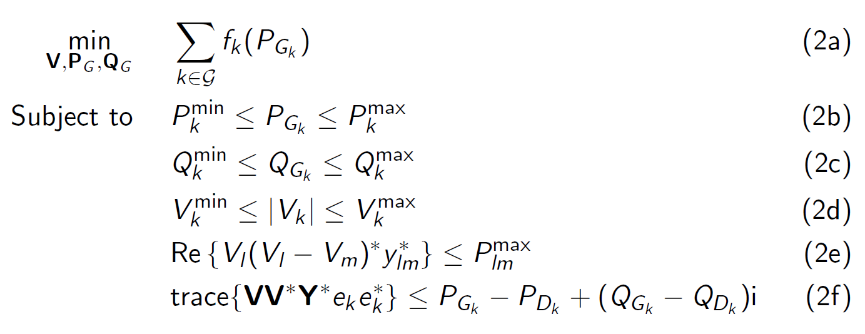
Optimal Power Flow
Express balance equations as inequalities:
Proof without this change involves geometric techniques.
Allow power over-delivery or assume positive LMPs.
Javad Lavaei, Columbia University
12

Slide 13
Various Relaxations
OPF
Dual OPF
SDP
R-SDP
SOCP
SDP relaxation has a rank-one solution for:
IEEE systems with 14, 30, 57, 118, 300 buses
European grid
Exactness of SDP relaxation and zero duality gap are equivalent for OPF.
Javad Lavaei, Columbia University
13

Slide 14
Zero Duality Gap
OPF:
Real-valued (DC)
Complex-valued (AC)
Networks:
Distribution (acyclic)
Transmission (cyclic)
DC lines are becoming more deployed (Nordic circuit).
Theory applies to scheduling of EVs charging, control of PV invertors,...
Javad Lavaei, Columbia University
14

Slide 15
AC Transmission Networks
How about AC transmission networks?
May not be true for every network
Various sufficient conditions
Result 1: AC transmission network manipulation:
High performance (lower generation cost)
Easy optimization
Easy market (positive LMPs and existence of eq. pt.)
Result 2: Reduced computational complexity
PS
Bus-4
Bus-2
Bus-3
Bus-5
Bus-1
Javad Lavaei, Columbia University
15

Slide 16
Simulations
Simulations:
Zero duality gap for IEEE 30-bus system
Guarantee zero duality gap for all possible load profiles?
Theoretical side: Add 12 phase shifters
Practical side: 2 phase shifters are enough
IEEE 118-bus system needs no phase shifters (power loss case)
Javad Lavaei, Columbia University
16

Slide 17
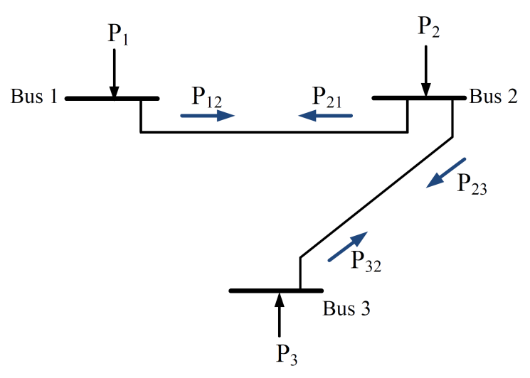
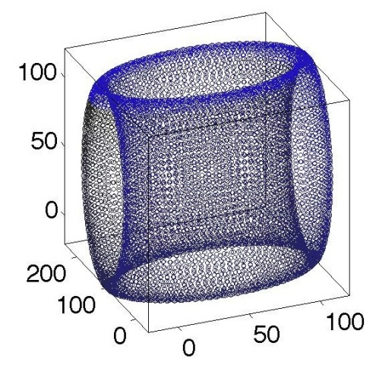
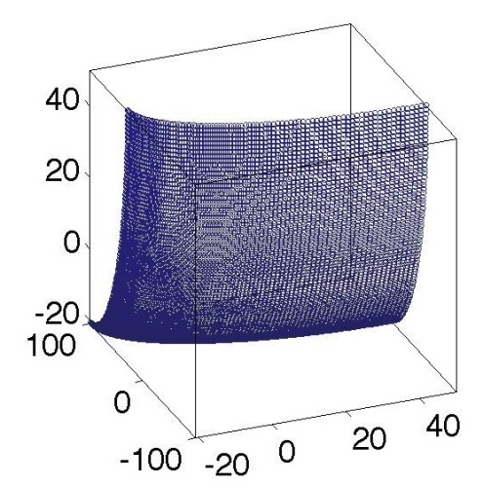
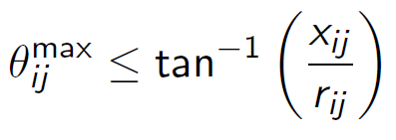
OPF With Equality Constraints
Injection region under fixed voltage magnitudes:
When can we allow equality constraints? Need to study Pareto front
Javad Lavaei, Columbia University
17

Slide 18
Convexification in Polar Coordinates
Similar to the condition derived in Ross Baldick’s book
Imposed implicitly (thermal, stability, etc.)
Imposed explicitly in the algorithm
Javad Lavaei, Columbia University
18

Slide 19
Convexification in Polar Coordinates
Idea:
Algorithm:
Fix magnitudes and optimize phases
Fix phases and optimize magnitudes
Javad Lavaei, Columbia University
19

Slide 20
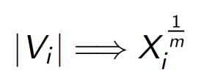
Convexification in Polar Coordinates
Can we jointly optimize phases and magnitudes?
Change of variables:
Assumption (implicit or explicit):
Observation 1: Bounding |V_{i}| is the same as bounding X_{i}.
Observation 2: is convex for a large enough m.
Observation 3: is convex for a large enough m.
Observation 4: |V_{i}|² is convex for m ≤ 2.
Javad Lavaei, Columbia University
20

Slide 21
Lossy Networks
Relationship between polar and rectangular?
Assumption (implicit or explicit):
Conjecture: This assumptions leads to convexification in rectangular coordinates
(partially proved).
Javad Lavaei, Stanford University
Javad Lavaei, Columbia University
17
21

Slide 22
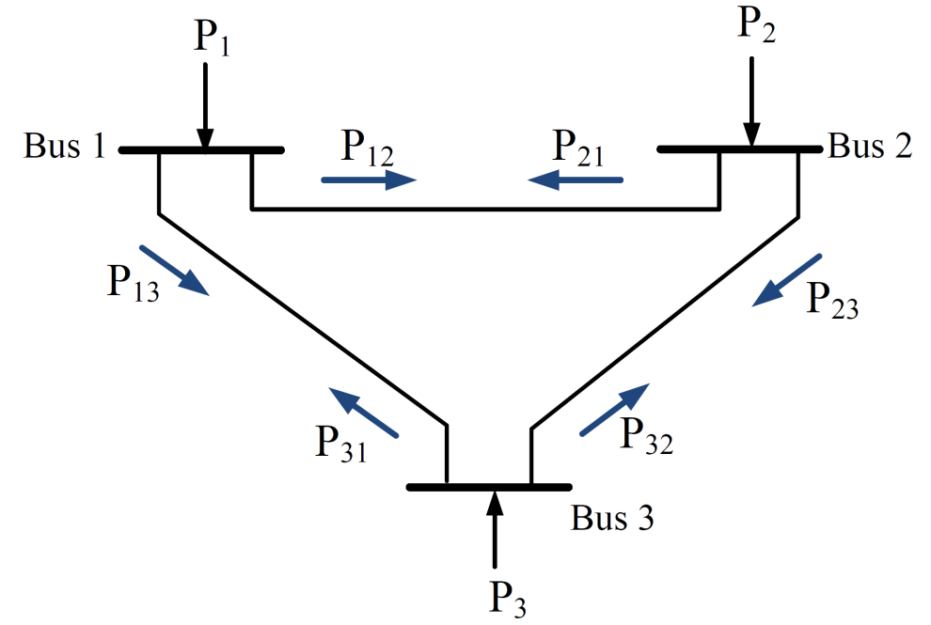
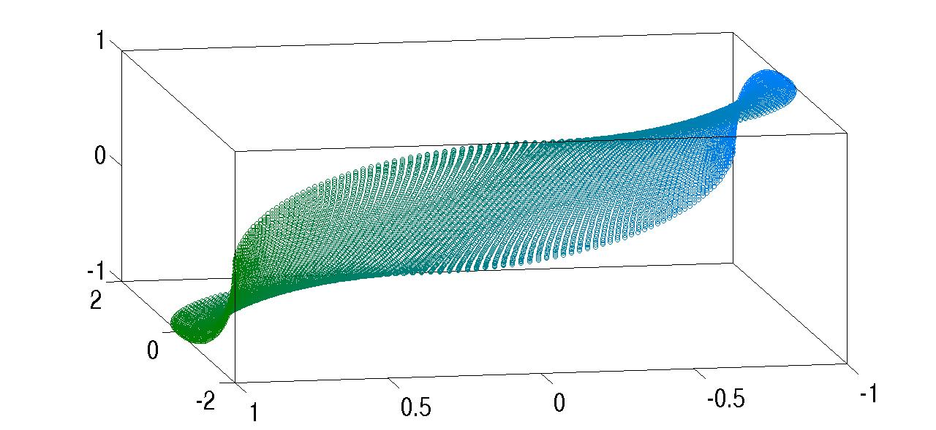
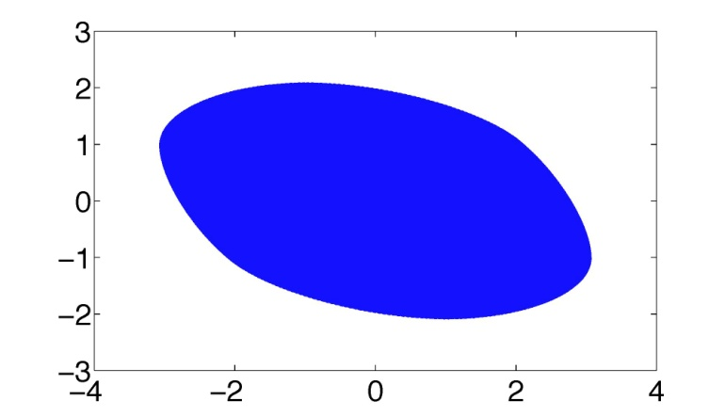
Lossless Networks
Consider a lossless AC transmission network.
Lossless 3 bus
(P₁₂,P₂₃,P₃₁)
(P₁,P₂)
SDP does not work well on lossless networks.
Javad Lavaei, Stanford University
Javad Lavaei, Columbia University
17
22

Slide 23
Lossless Networks
Solution: Penalize the rank constraint in the objective:
Simulation for a 10-bus cycle:
1) W has 8 nonzero eigs, but the regularization kills 7 of all (zero duality gap).
2) This regularization is guaranteed to kill all but 1-2 eigs.
3) Randomized “M” gives us the correct answer (nonzero duality gap).
Javad Lavaei, Stanford University
Javad Lavaei, Columbia University
17
23

Slide 24
Conclusions
Focus: OPF with a 50-year history
Goal: Find a global solution efficiently
Obtained provably global solutions for many practical OPFs
Developed various theories for distribution and transmission networks
Several companies working on these ideas
Javad Lavaei, Columbia University
24

