Slide 1

Javad Lavaei
Department of Electrical Engineering
Columbia University
Joint work with Somayeh Sojoudi
Convexification of Optimal Power Flow Problem by Means of Phase Shifters

Slide 2

Power Networks
Optimizations:
  Optimal power flow (OPF)
  Security-constrained OPF
  State estimation
  Network reconfiguration
  Unit commitment
  Dynamic energy management
Issue of non-convexity:
  Discrete parameters
  Nonlinearity in continuous variables
Transition from traditional grid to smart grid:
  More variables (10X)
  Time constraints (100X)
Javad Lavaei, Columbia University
2

Slide 3
Broad Interest in Optimal Power Flow
OPF-based problems solved on different time scales:
  Electricity market
  Real-time operation
  Security assessment
  Transmission planning
Existing methods based on linearization or local search
Question: How to find the best solution using a scalable robust algorithm?
Huge literature since 1962 by power, OR and Econ people
Javad Lavaei, Columbia University
3

Slide 4
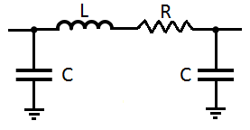
Summary of Results
Project 1: How to solve a given OPF in polynomial time? (joint work with Steven Low)
A sufficient condition to globally solve OPF:
  Numerous randomly generated systems
  IEEE systems with 14, 30, 57, 118, 300 buses
  European grid
Various theories: It holds widely in practice
Project 2: Find network topologies over which optimization is easy? (joint work with Somayeh Sojoudi, David Tse and Baosen Zhang)
Distribution networks are fine (under certain assumptions).
Every transmission network can be turned into a good one (under assumptions).
Javad Lavaei, Columbia University
4

Slide 5
Summary of Results
Project 3: How to design a distributed algorithm for solving OPF? (joint work with Stephen Boyd, Eric Chu and Matt Kranning)
A practical (infinitely) parallelizable algorithm
It solves 10,000-bus OPF in 0.85 seconds on a single core machine.
Project 4: How to do optimization for mesh networks? (joint work with Ramtin Madani and Somayeh Sojoudi)
Developed a penalization technique
Verified its performance on IEEE systems with 7000 cost functions
Focus of this talk: Revisit Project 2 and remove its assumptions
Javad Lavaei, Columbia University
5

Slide 6
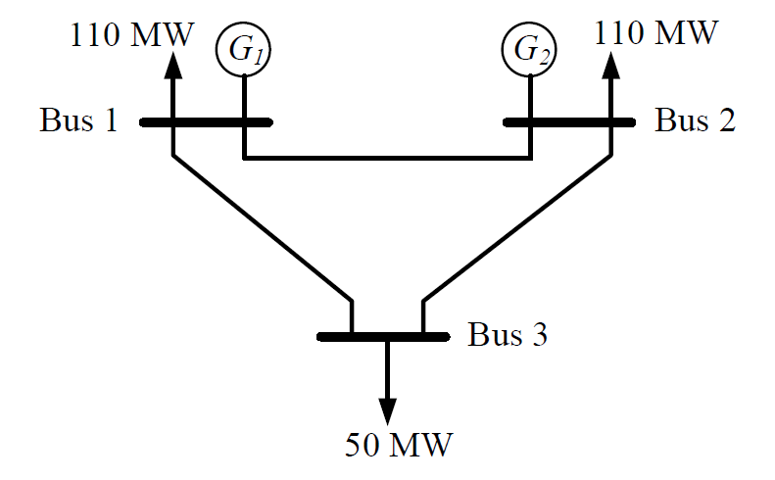
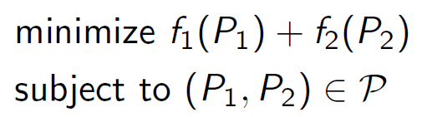


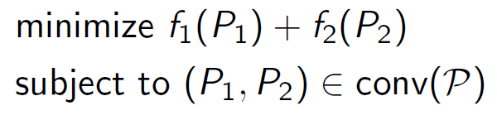
Geometric Intuition: Two-Generator Network
Javad Lavaei, Columbia University
6

Slide 7
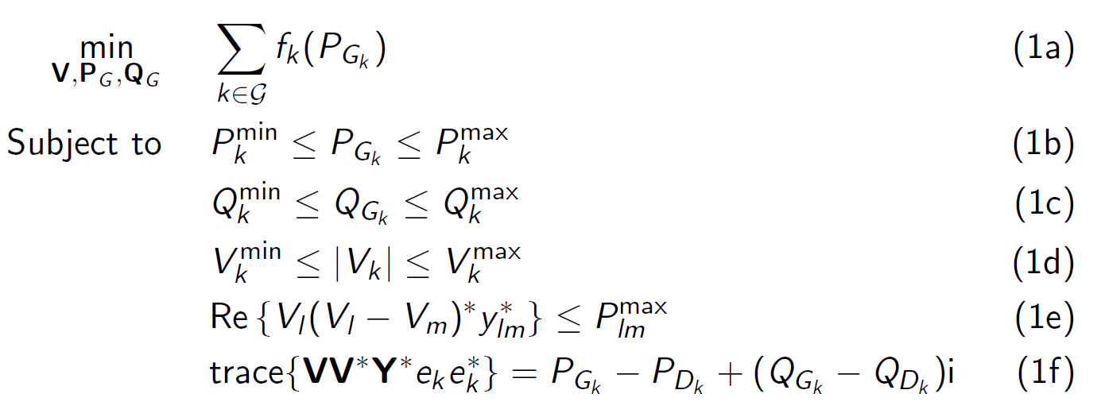
Optimal Power Flow
Cost
Operation
Flow
Balance
SDP relaxation: Remove the rank constraint.
Exactness of relaxation: We study it thru a geometric approach.
Javad Lavaei, Columbia University
7

Slide 8
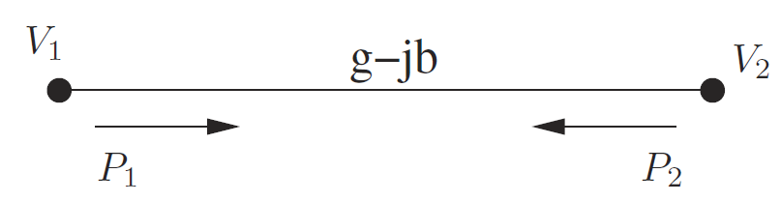
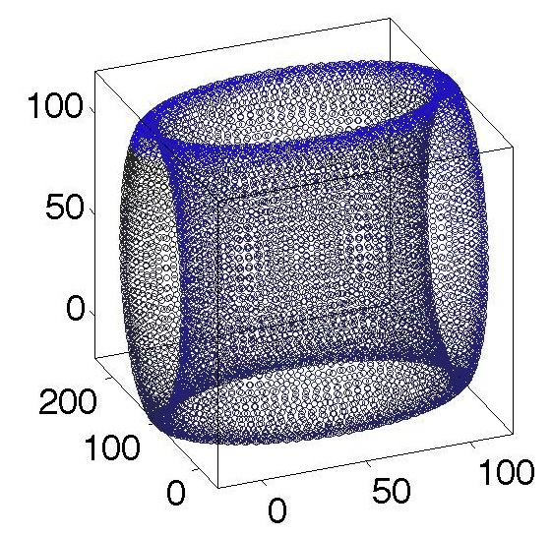
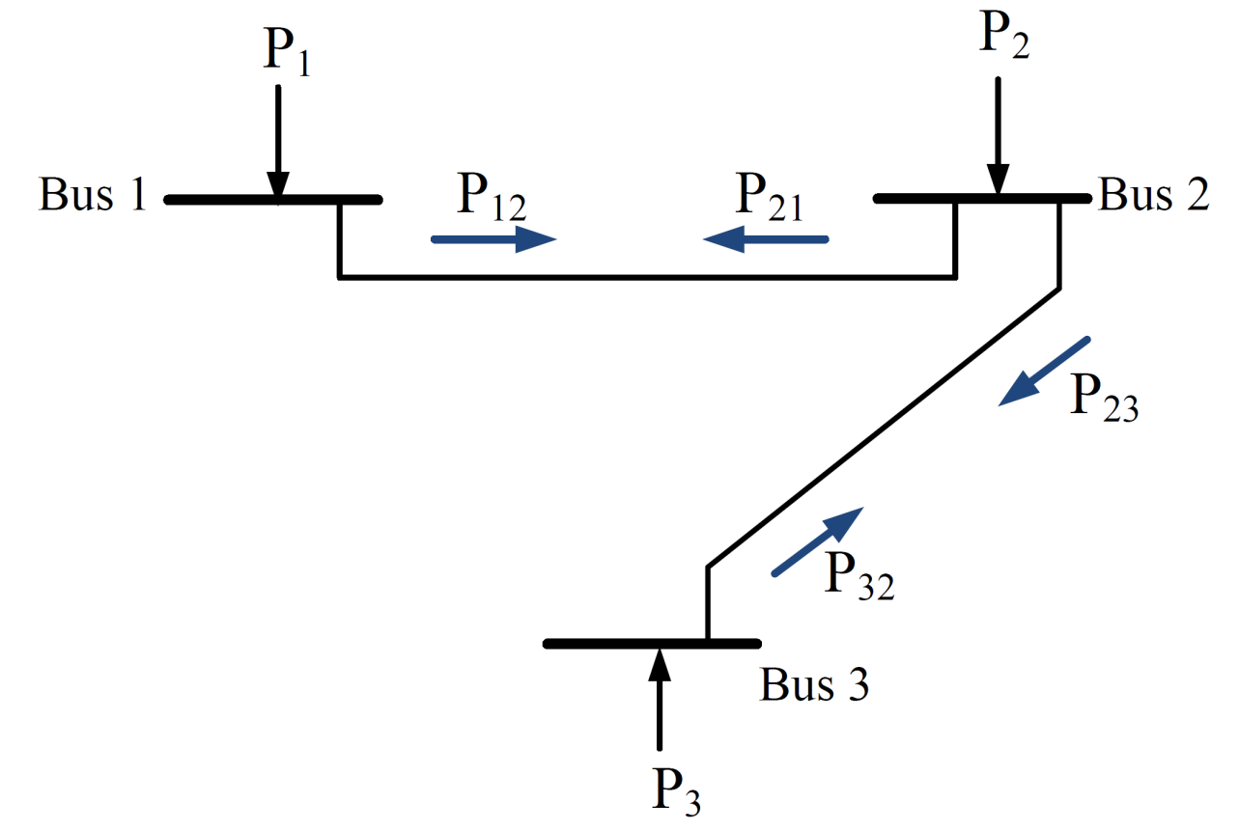
Acyclic Three-Bus Networks
Assume that the voltage magnitude is fixed at every bus.
Javad Lavaei, Columbia University
8

Slide 9
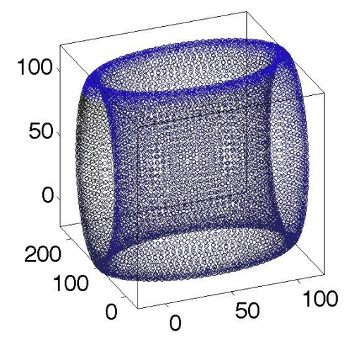
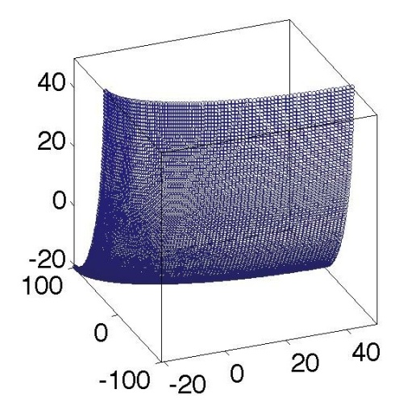
Geometric Interpretation
Pareto face:
(+,+)
Pareto face
Convex Pareto Front: Injection region and its convex hull share the same front.
Javad Lavaei, Columbia University
9

Slide 10

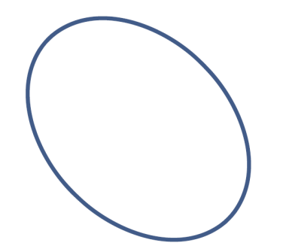
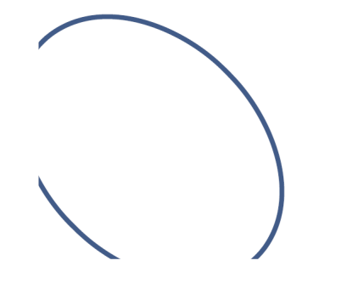
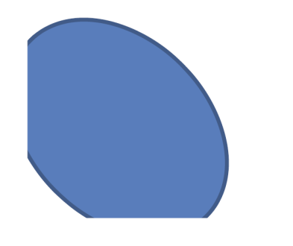
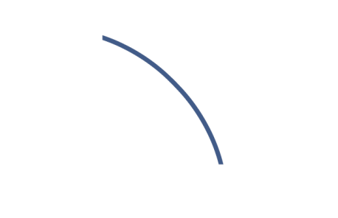
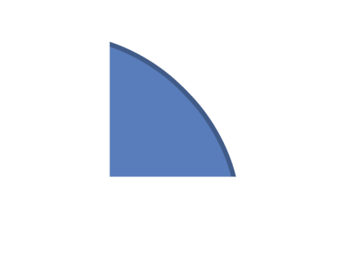
Two-Bus Network
Two-bus network with power constraints:
P₁
P₁
P₁
P₂
P₂
P₂
P₁
P₁
P₁
P₂
P₂
P₂
Javad Lavaei, Columbia University
10

Slide 11
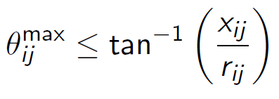
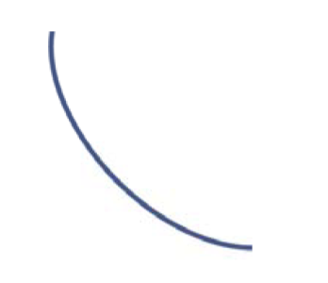
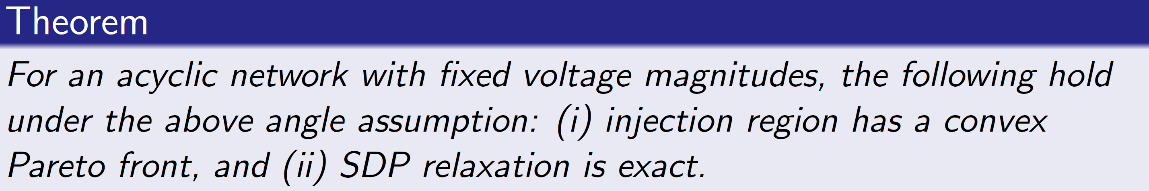
General Tree Network
Assume that each flow-restricted region is already Pareto (monotonic curve):
P_{ij}
P_{ji}
Ratio from 1 to 10: Max angle from 45º to 80º
Javad Lavaei, Columbia University
11

Slide 12


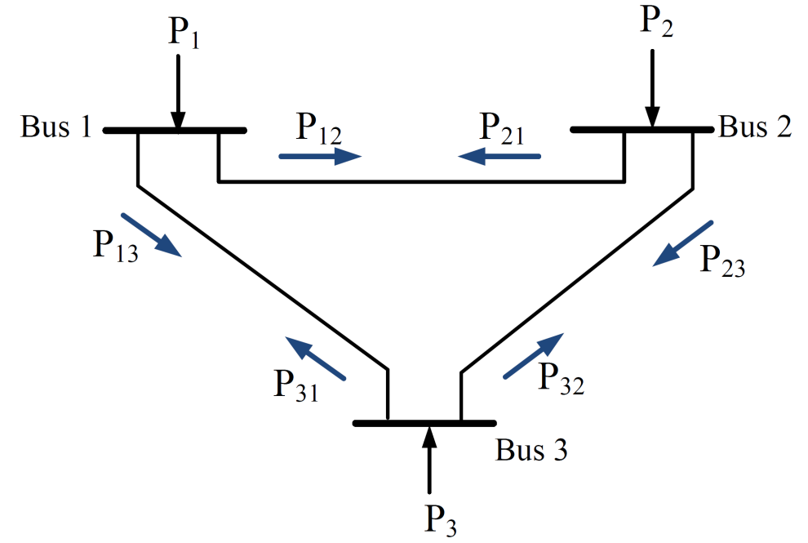


Three-Bus Networks
  Variable voltage magnitude:
Issues: Coupling thru angles and voltage magnitudes
Javad Lavaei, Columbia University
12

Slide 13

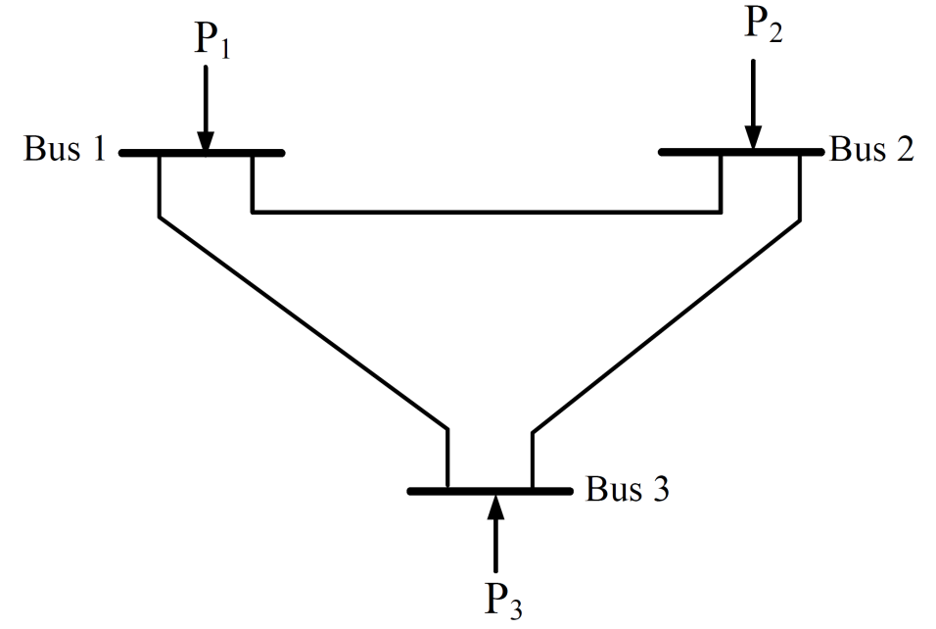
Decoupling Angles
Phase shifter: An ideal transformer changing a phase
Phase shifter kills the angles coupling.
PS
Javad Lavaei, Columbia University
13

Slide 14
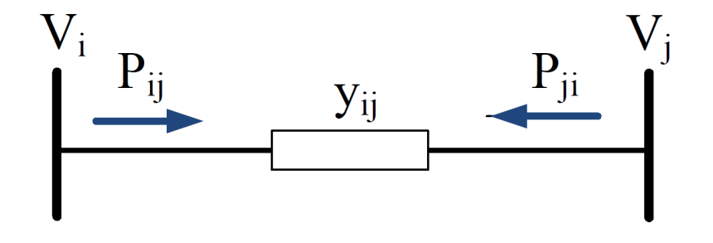
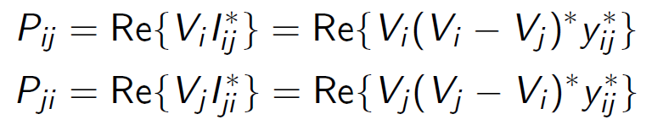
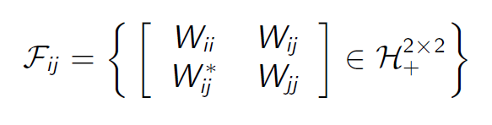
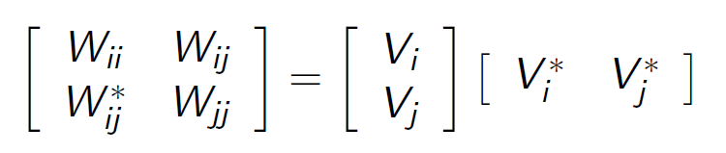
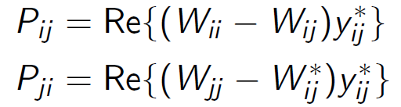

Decoupling Voltage Magnitudes
Define:
Boundary
Javad Lavaei, Columbia University
14

Slide 15
Injection & Flow Regions
Line (i,j):
Voltage coupling introduces linear
equations in a high-dimensional space.
Javad Lavaei, Columbia University
15

Slide 16
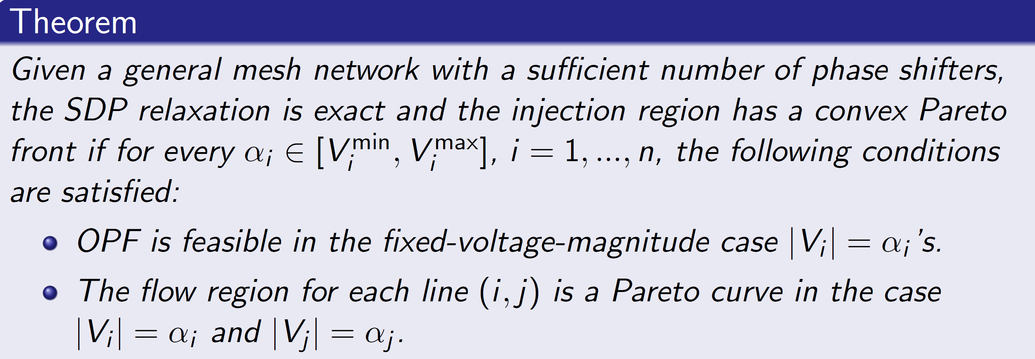
Main Result
Current practice in power systems:
  Tight voltage magnitudes.
  Not too large angle differences.
Adding virtual phase shifters is often the only relaxation needed in practice.
Javad Lavaei, Columbia University
16

Slide 17
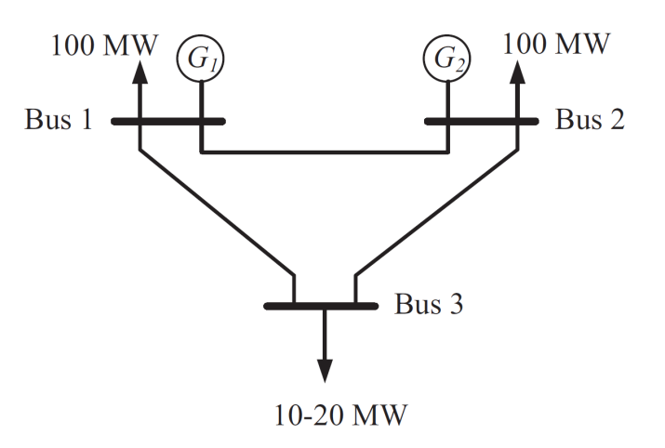
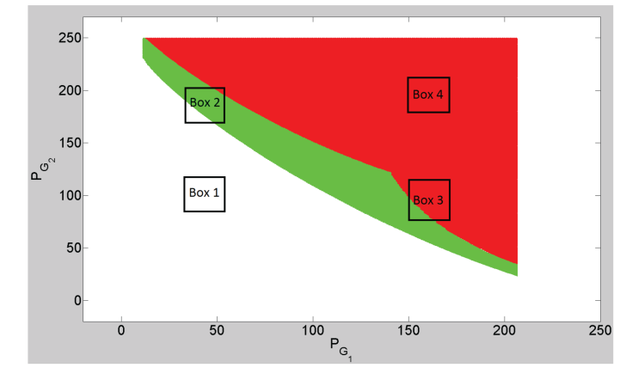
Phase Shifters
Blue: Feasible set (P_{G1},P_{G2})
Green: Effect of phase shifter
Red: Effect of convexification
Minimization over green = Minimization over green and red (even with box constraints)
Javad Lavaei, Columbia University
17

Slide 18
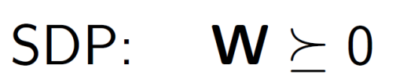
Phase Shifters
Simulations:
  Zero duality gap for IEEE 30-bus system
  Guarantee zero duality gap for all possible load profiles?
  Theoretical side: Add 12 phase shifters
  Practical side: 2 phase shifters are enough
  IEEE 118-bus system needs no phase shifters (power loss case)
Phase shifters speed up the computation:
Javad Lavaei, Columbia University
18

Slide 19
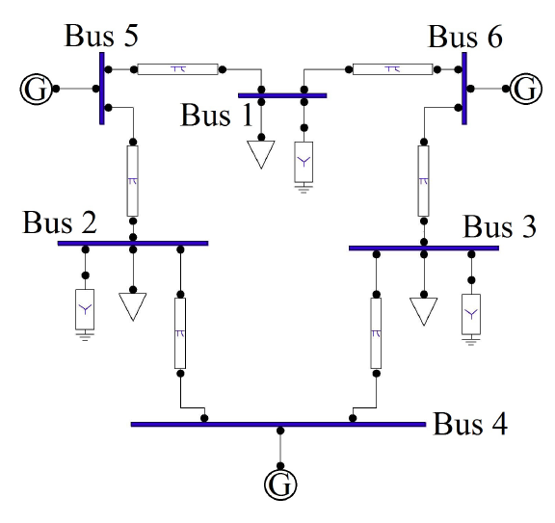
Conclusions
Focus: OPF with a 50-year history
Goal: Find a near-global solution efficiently
Main result: Virtual phase shifters make OPF easy under tight voltage magnitudes and not too loose angle differences.
Future work: How to lessen the effect of virtual phase shifters?
Javad Lavaei, Columbia University
19

